Slide 1
CSC 4904
Final Year Project 2

Slide 2
Technical Report : Common Mistakes
Acronyms/abbreviations – first time introduced need to use full name, then can use the acronym.
Short and precise sentences – no long, winding, repetitive sentences
Use of punctuations correctly - ; , “”
Caption for figures/tables
centered, Figures – at the bottom and Table – at the top
Use Insert → Caption
Use proper numbering for formatting – section, subsection, table, figures (all are automated using Word)
GRAMMAR – past/present tense- Singular/plural
Use of words. E.g. some, good enough – not precise/ambiguous
Methodology
need to be specific to your project, not copy and paste from other projects
Use of capital letters
Figures/Tables that are copied from some other resources (image, ppt, xls) need to be CLEAR– can be read/seen clearly.
When there is Figure/Table – make sure there is a text describing/explaining about it

Slide 3
Technical Report : Common Mistakes
Texts should be in “Justified” format
Proof read
Spellcheck – Use Word tool
Basic grammar – Use Word tool
Read your friend’s report – at the same time can learn something new apart from proofreading
Difference between It’s or its
Reports are formal writing – Write words in full, e.g. do not (not don’t), cannot, is not…
Formal sentences – not casual conversations
Consistency → language – tenses, font
Paragraph – spacing, justified, format, numbering and indentation
References – do not copy and paste the sentences – REPHRASE
Passive/active voice
Justify your statements with references
TIPS:
Reviewers/examiners are busy. Try to make their work easier

Slide 4
Some Sample of Technical Report

Slide 5
FYP SHOWCASE
Date : 29th, 30th April and 2nd May
Venue : LR14/LR14A
What to present? POSTER.
Who are your examiner
1 your technical report examiner
1 appointed examiner

Slide 6
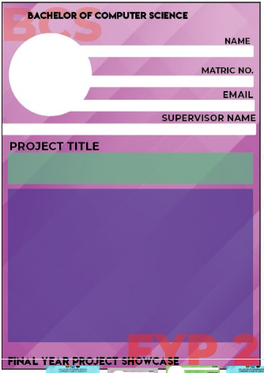
FYP Showcase e-book
https://docs.google.com/forms/d/e/1FAIpQLSdfvW0JMJsnIQdIacmKWibnnEH7gXR73dt7B1o0ZtAN5yTrEg/viewform
BEFORE 5th APRIL 2019

Slide 7
deadlines
Date | Deliverables
5th April 2019 (week 9) | Technical report
 | Gform for FYP e-book
19th April 2019 (week 11) | Poster

Slide 8
SUBMIT TODAY……..
https://forms.gle/nrh3YCG3rDByHyjF8

